Slide 1

DistilBERT
Ulises Gallardo Rodríguez

Slide 2
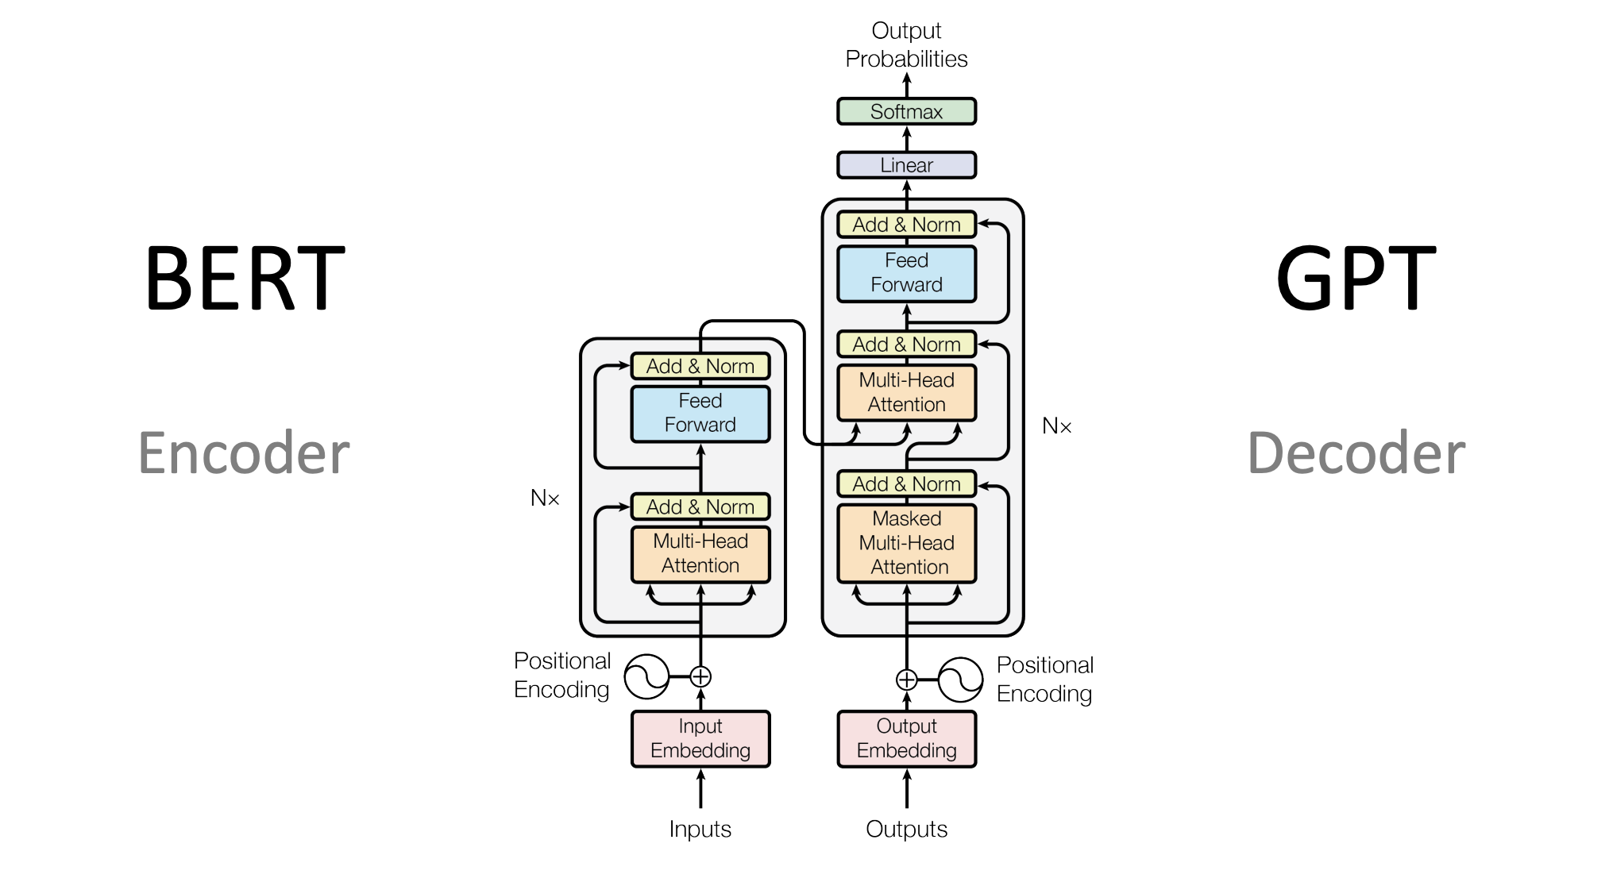
TRANSFORMERS
Aprende y captura información contextual de la secuencia: Context Matters
Genera secuencias de salida autorregresivas basadas en las representaciones aprendidas por el encoder

Slide 3
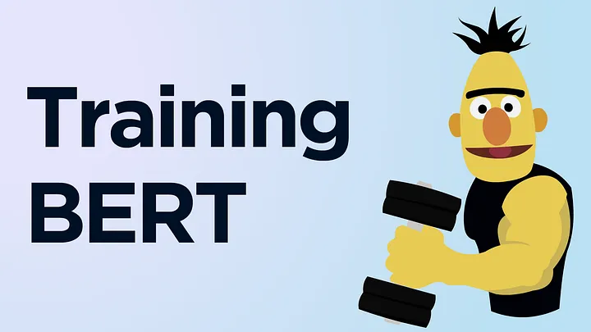
BERT

Slide 4
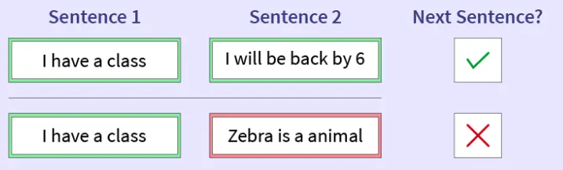
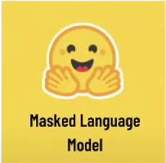
Masked Language Model
Next Sentence Prediction
Paris is the [MASK] of France
Capital

Slide 5
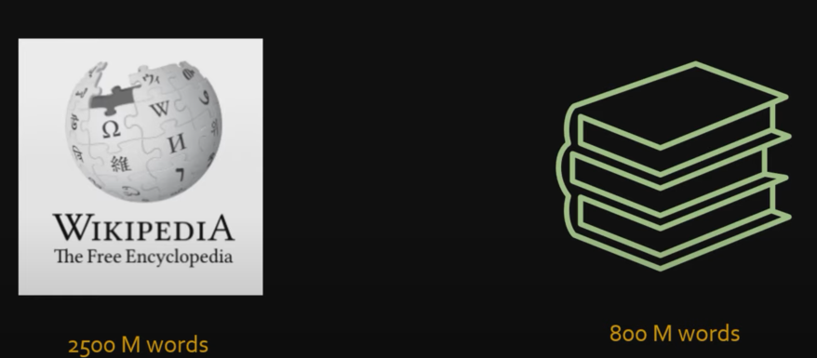

DATASET
16 GB of data (books corpus + wikipedia) = 3.3 Billion words

Slide 6
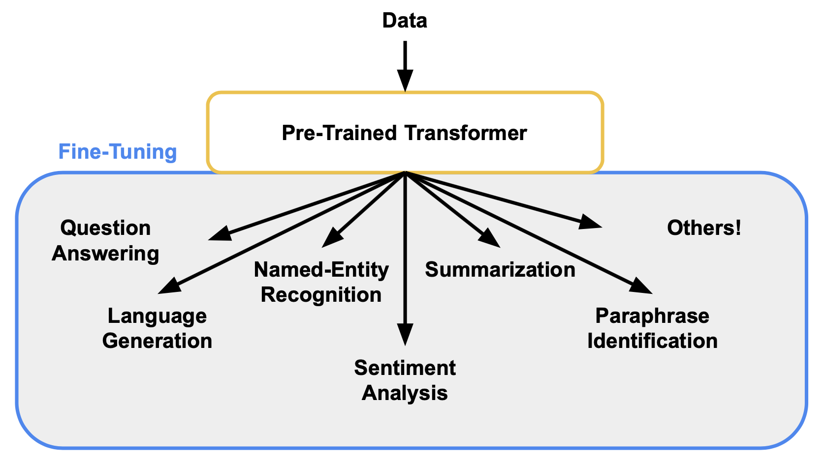
FINE TUNE TO SPECIFIC TASK

Slide 7
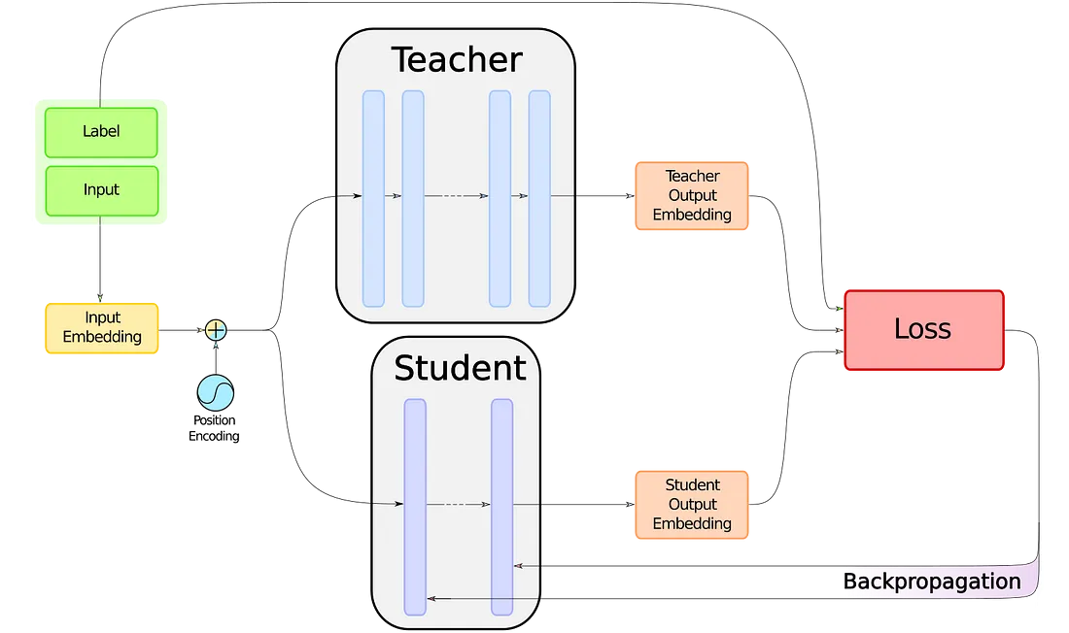
DISTILLATION

Slide 8
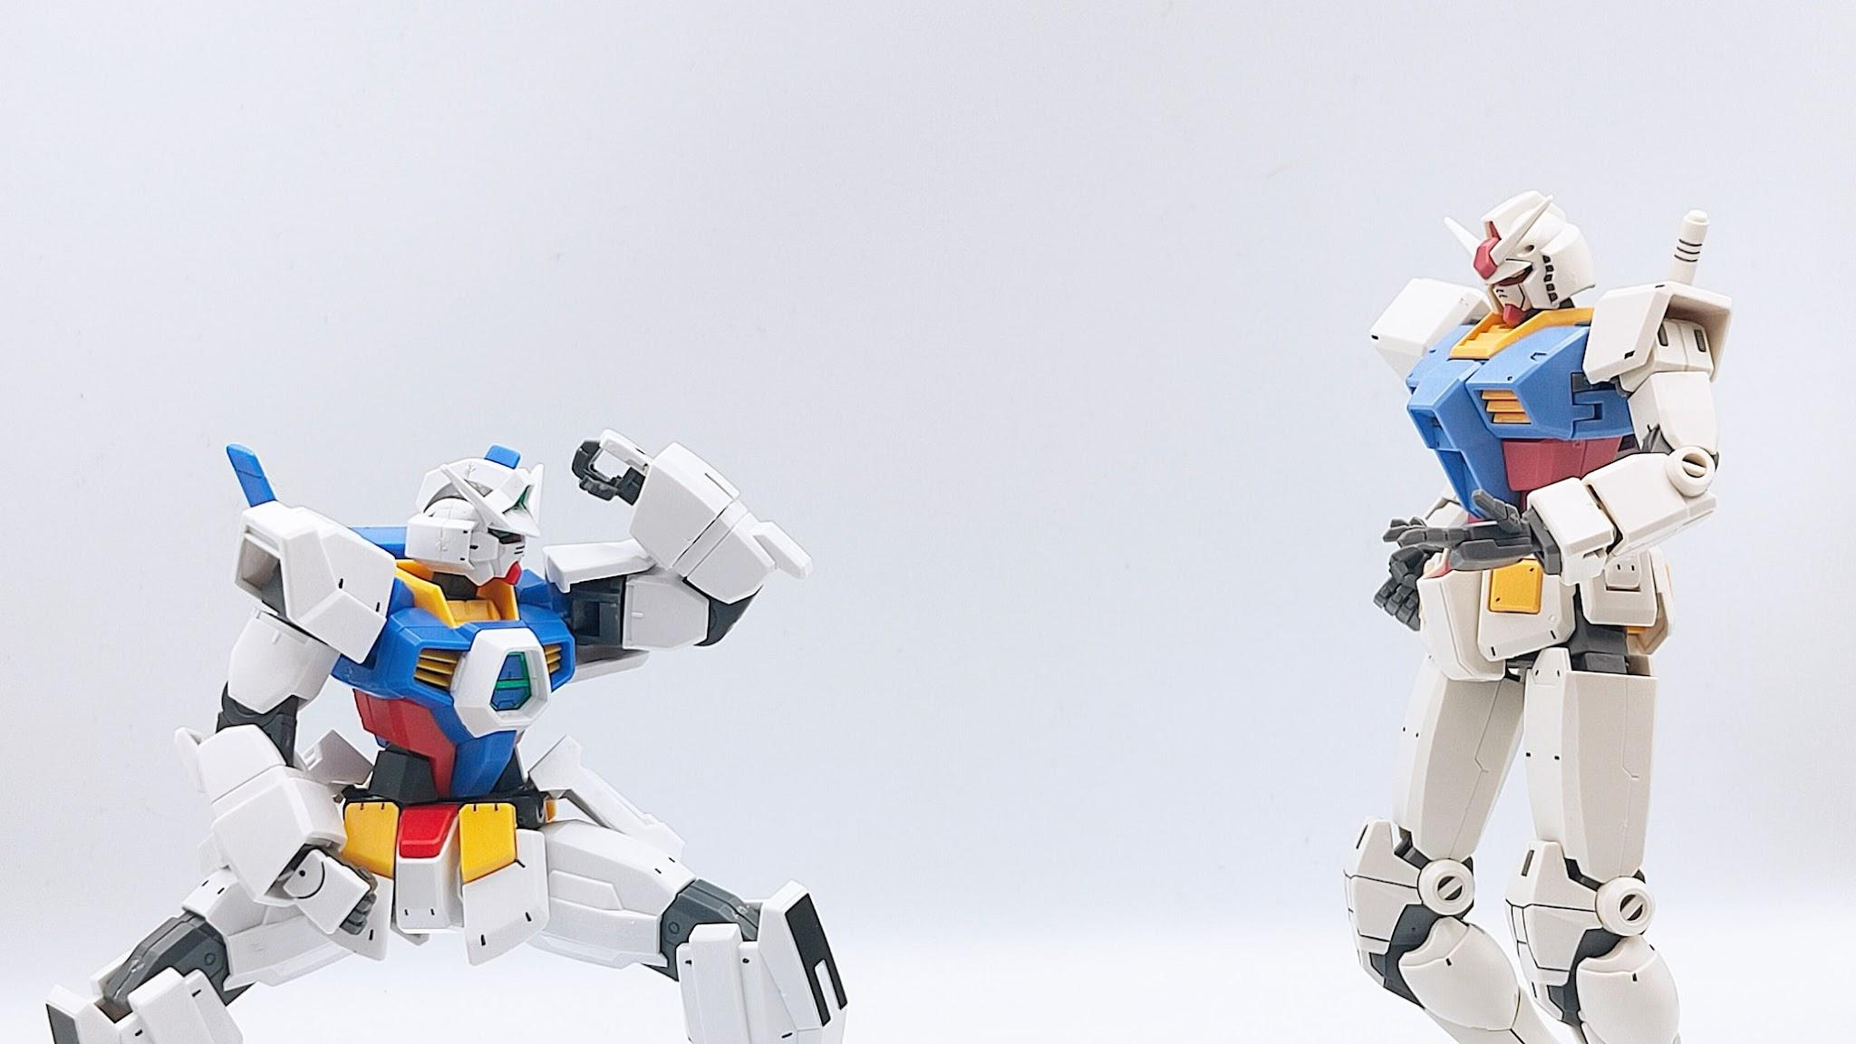
BERT vs DistilBERT
DistilBERT retains 97% of BERT performance with 40% fewer parameters and it’s 60% faster.
 | # param (Millions) | Inference Time (seconds) | Train Power | IMDb (acc.)
BERT-base | 110 | 668 | 8 V100 for 12 days* | 93.46
DistilBERT | 66 | 410 | 8 16GB V100 GPUs for approximately 90 hours (4 times less than BERT) | 92.82

Slide 9
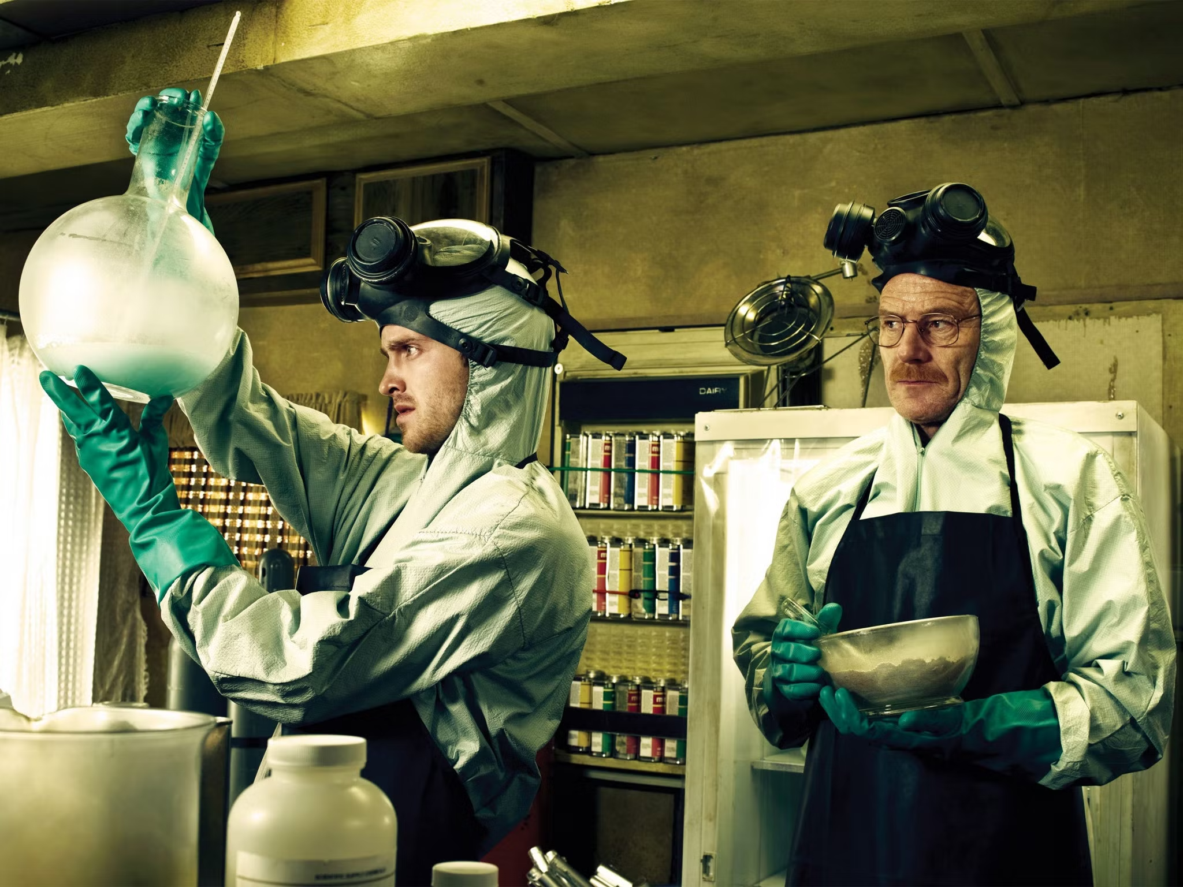
CONCLUSIONS
BERT
distilBERT

Slide 10
REFERENCIAS
https://arxiv.org/abs/1910.01108
https://huggingface.co/learn/nlp-course/chapter1/1
https://www.youtube.com/watch?v=H39Z_720T5s&t=131s
https://www.youtube.com/watch?v=xI0HHN5XKDo
https://towardsdatascience.com/distillation-of-bert-like-models-the-theory-32e19a02641f
http://jalammar.github.io/illustrated-bert/

